Slide 1
The Collaborative Process on the Second-Generation Cut-Off and Section 10 Voting Thresholds
Information Session | July 2024
‹#›

Slide 2
Meeting Purpose
Clarify and review information in the Rights Holders Kit
Address questions and concerns raised by participants
Initiate discussions on key issues
Prepare rights holders for upcoming consultation
Facilitate engagement and participation

Slide 3
Support
If you or someone you know is in crisis or needs emotional support, these resources can help:
Hope for Wellness Help Line Call 1-855-242-3310 (toll-free) or connect to the online Hope for Wellness chat. Available 24 hours a day, 7 days a week to First Nations, Inuit, and Métis Peoples seeking emotional support, crisis intervention, or referrals to community-based services. Support is available in English and French and, by request, in Cree, Ojibway, and Inuktitut.
The National Residential School Crisis Line Crisis support is available to Residential School survivors and their families 24 hours a day, 7 days a week at
1-866-925-4419 (toll-free).

Slide 4
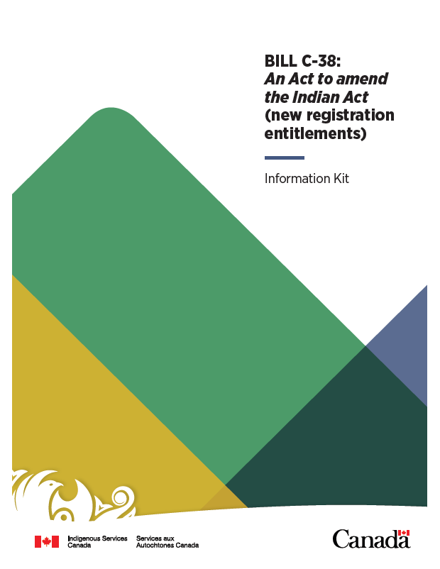
Bill C-38
Bill C-38, An Act to amend the Indian Act (new registration entitlements) was introduced in Parliament on December 14, 2023.
Bill C-38 addresses 4 issues:
Enfranchisement
Natal Band Membership
Individual Deregistration
Removal of some outdated and offensive language

Slide 5
Overview of the Collaborative Process
Indigenous Advisory Process
Rights-Holders Information Kit
Co-design of the consultation materials in collaboration with 17 Indigenous Organizations.
A kit detailing the issues for consultation, including community-specific data.
Co-development and Information
Sharing Phase
Consultation Readiness Form
ISC Led Information Sessions
An optional form First Nations may fill out to let the Department know they are ready to participate in the consultation process.
ISC is hosting a variety of information sessions to help prepare participants for the consultation events.
First Nation & Organization
Led Events
Department Led Activities
Consultation Events and
Activities Phase
Consultation events led by ISC to discuss key issues, themes, and potential
legislative remedies.
Consultation events led by First Nations and Organizations.

Slide 6
Indigenous Advisory Process Participants List
NATIONAL INDIGENOUS ORGANIZATION TABLE
Assembly of First Nations - British Columbia
Assembly of First Nations - Manitoba
Assembly of First Nations - National
Anishinabek Nation
Assembly of Nova Scotia Mi'kmaq Chiefs
Congress of Aboriginal Peoples
First Nations Summit of British Columbia
Indigenous Bar Association
National Association of Friendship Centers
Native Women's Association of Canada
Union of British Columbia's Indian Chiefs
WOMEN’S AND YOUTH CAUCUS
Warriors Rising Youth Society
Feminist Alliance for International Action
Indigenous Youth Council for the National Association of Friendship Centers
Ontario First Nations Young Peoples Council
Ontario Native Women's Association
Quebec Native Women's Association

Slide 7
Application of the Second-Generation Cut-Off
ANCESTOR
Entitled under 6(1)(a/a.1/a.2/a.3)
After two consecutive generations of parenting with a person who is not entitled to registration, the third generation is no longer entitled to registration.
*FIRST GENERATION
Entitled under 6(1)(a/a.1/a.2/a.3)
*SECOND GENERATION
Entitled under 6(1)(a/a.1/a.2/a.3)
APRIL 17, 1985
*THIRD GENERATION
*SECOND GENERATION
*FIRST GENERATION
Entitled under 6(2)
Entitled under 6(2)
Entitled under 6(2)
*THIRD GENERATION
*SECOND GENERATION
NOT ENTITLED
NOT ENTITLED
*This graphic assumes no marriages, and that each person has one entitled parent

Slide 8
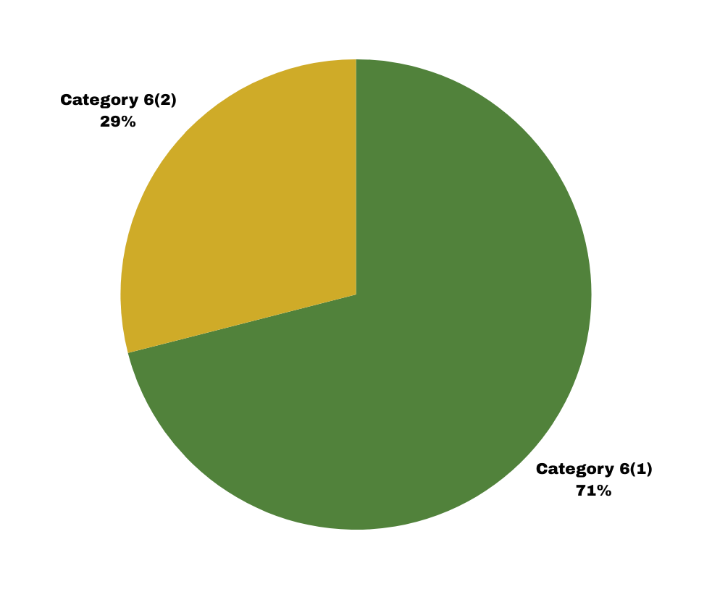
Demographic Impacts of the Second-Generation
Cut-Off Across Canada
If future descendants do not parent with an entitled individual, they may not be able to pass on entitlement to their children.
322,173
Despite a community connection, some children may not be able to access the rights, benefits, and services provided to registered individuals.
Individuals Actively Registered Under 6(2)
If the registration provisions of the Indian Act remain unchanged, the total registered population is expected to substantially decrease with time.

Slide 9
Possible Solutions to the Second-Generation
Cut-Off
Shifting to a one-parent rule
Requiring only one parent to be registered
Transfer of control to First Nations to decide who their people are
Common set of minimum requirements established and applied
Removing the categories completely
People are either registered or they are not, could be similar to the one-parent rule

Slide 10
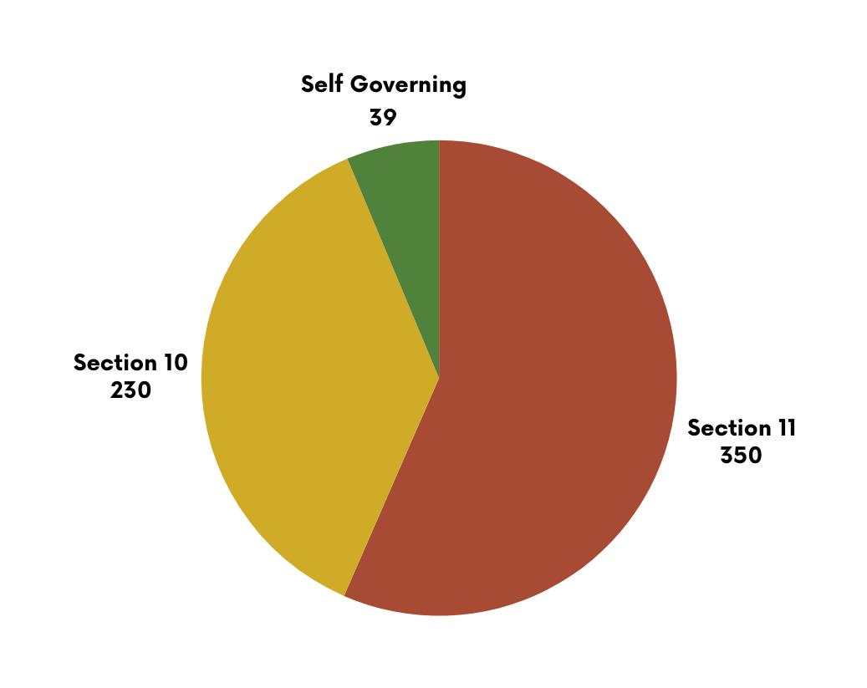
Band Membership under Section 10, Section 11,
and Self-Governing Agreements
Section 10 | First Nations can assume control of their band membership, however, registration for Indian Status is determined by Canada through the Indian Act
Section 11 | Registration is determined by Canada through the Indian Act, where entitled individuals automatically gain band membership to their affiliated First Nation
Self-Governing Agreement | First Nations can assume control of their band membership through rules and codes, approved by the Minister of ISC

Slide 11
Steps to Transition to Section 10
NOTICE I, II, & III A First Nation must inform eligible electors of the First Nations intention to assume control over their membership, and intention to establish membership rules for itself. The First Nation must also provide notice to the Minister of ISC.
CONSENT The First Nation must obtain consent from its eligible electors about the intention to assume control over membership and its intention to write its own membership code. Consent is only considered achieved when a “double majority” voting threshold is met.
ACQUIRED RIGHTS The membership rules must protect the acquired membership rights of individuals whose names were on the membership list maintained by the department up until the day before the First Nation assumes control of membership

Slide 12
Section 10 Voting Thresholds
Voting Threshold for 1,000 voters | Minimum number of voter that must participate in consent vote | Minimum number that must vote in favour
Absolute majority | 501 | 501
Double majority (Majority of a majority) | 501 | 251
25% + 1 | 251 | 251
Simple majority | No minimum | Of those that participate 50% +1
A double majority means that a majority of the eligible electors of the band must vote, and a majority of those who vote must be in favour
A potential solution to the second-generation cut-off may result in an additional 225,000 (or more) newly entitled individuals.
An influx of new members could make it more difficult to gain the consent of a majority of electors.

Slide 13
Timeline and Next Steps
MARCH 2023
JULY
2023
NOVEMBER
2023
APRIL
2024
MAY
2024
AUGUST
2024
LATE SUMMER 2024
FALL
2024
MINISTER OF ISC COMMITS TO LAUNCHING A COLLABORATIVE PROCESS
PUBLIC LAUCH OF THE INDIGENOUS ADVISORY PROCESS
INFORMATION SESSIONS ON KEY ISSUES BEGIN
CO-DEVELOPMENT PHASE ENDS -CONSULTATION PLAN IS RELEASED
INVITATIONS DISTRIBUTED TO PARTNERS INVITED TO THE INDIGENOUS ADVISORY PROCESS
RIGHTS-HOLDERS KITS ARE DISTRIBUTED VIA PRINT, EMAIL, AND POSTED ONLINE
CONSULTATION EVENTS AND ACTIVITY PLANNING - INFORMATION SESSIONS CONTINUE
CALL OUT FOR APPLICATIONS IS RELEASED TO ORGANIZATIONS & FIRST NATIONS
PUBLIC LAUNCH OF THE CONSULTATION EVENTS AND ACTIVITIES PHASE

Slide 14
Engage and Participate: Ways to Get Involved
Stay connected with updates and engagement opportunities by visiting the Indigenous Services Canada website.
For inquiries, guidance, or support, please contact us at:
Reforme-de-linscription-Registration-Reform@sac-isc.gc.ca

